Slide 1

CAR
RENTAL
OBJECT ORIENTED ANALYSIS & DESIGN WITH UML GROUP PROJECT
BEGUM SOZER-AMAR ADAM BENADJAOUD-GAEL FLOQUET

Slide 2

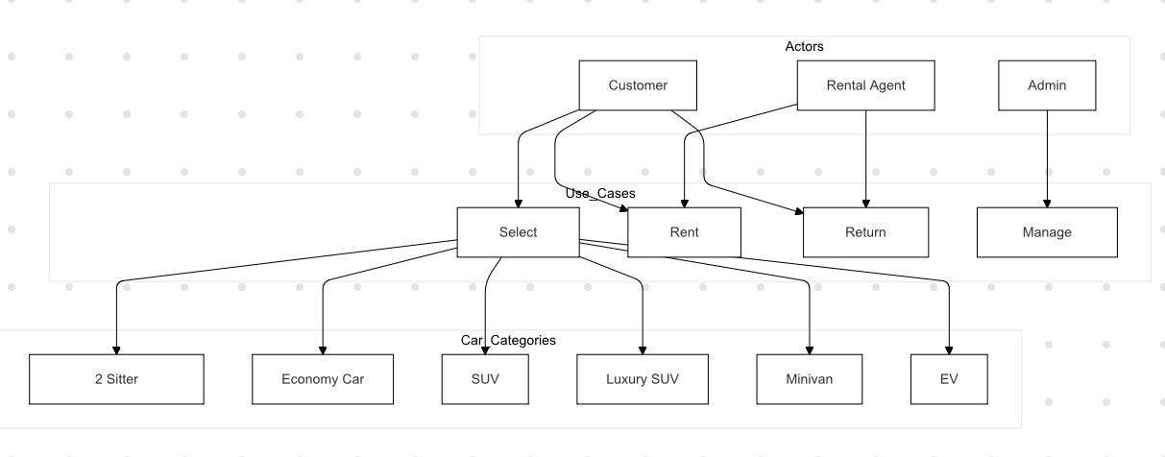
USE CASE
DIAGRAM

Slide 3
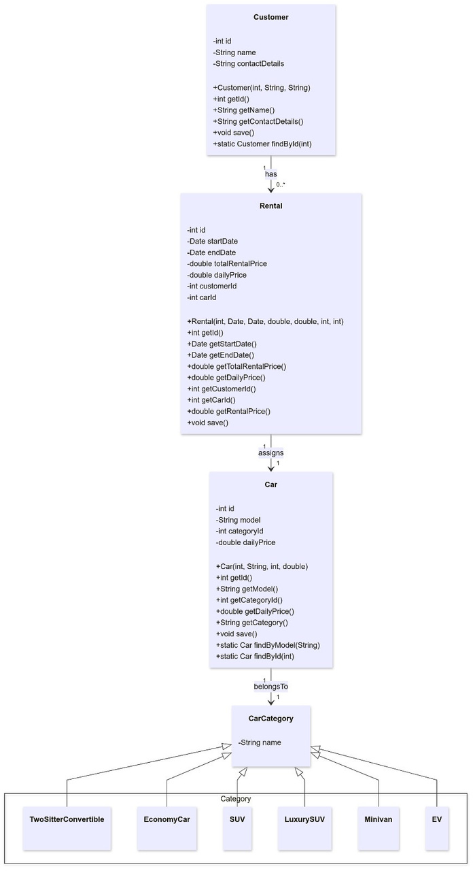
CLASS
DIAGRAM

Slide 4
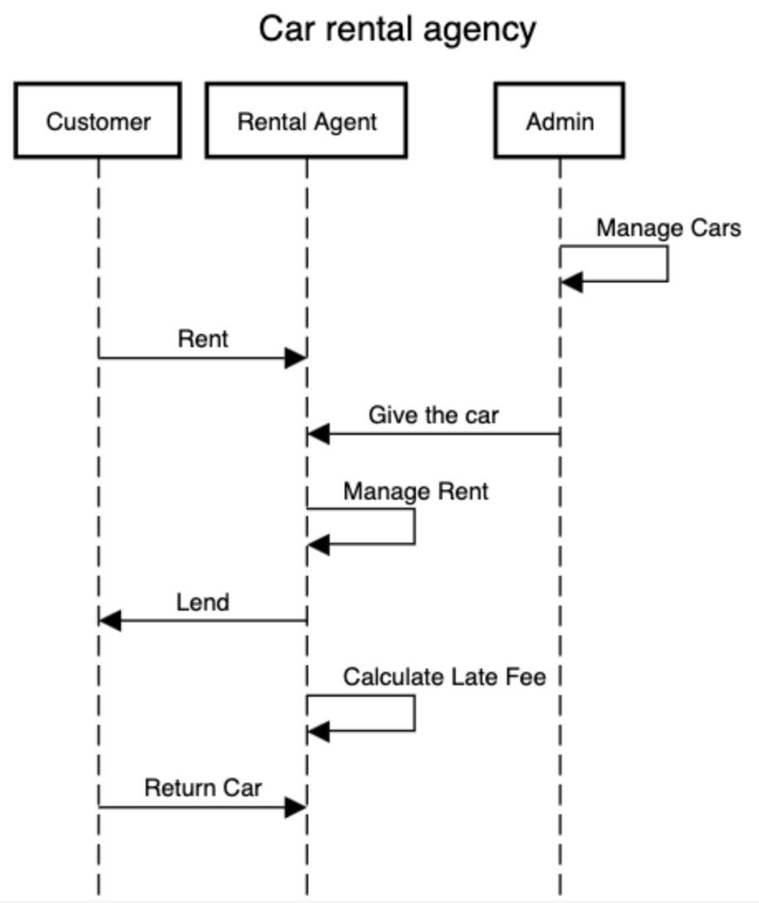
SEQUENCE
DIAGRAM

Slide 5
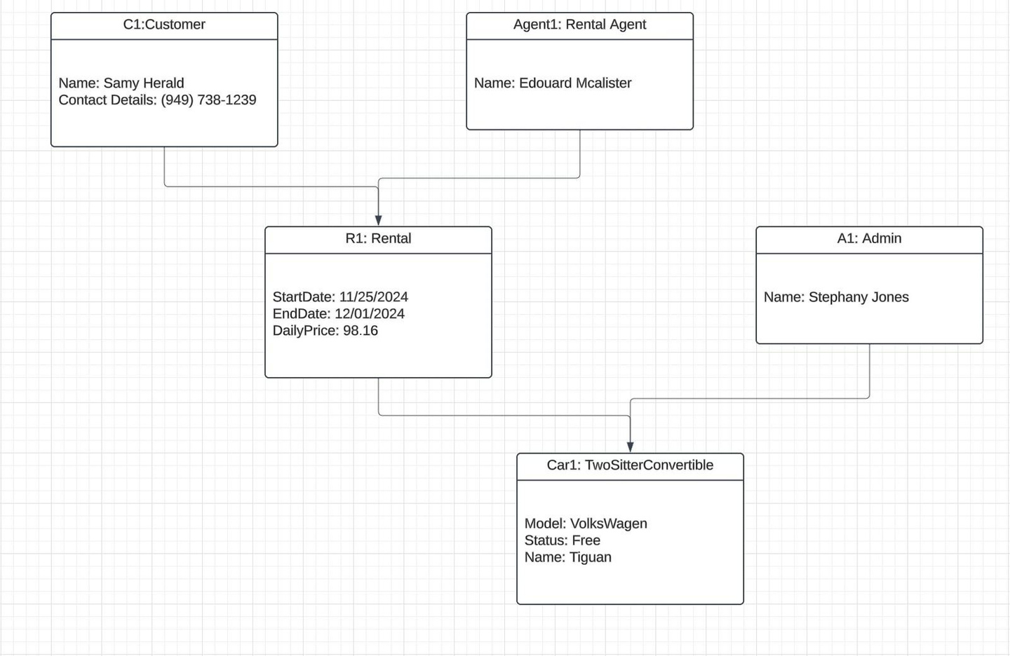
OBJECT
DIAGRAM

Slide 6
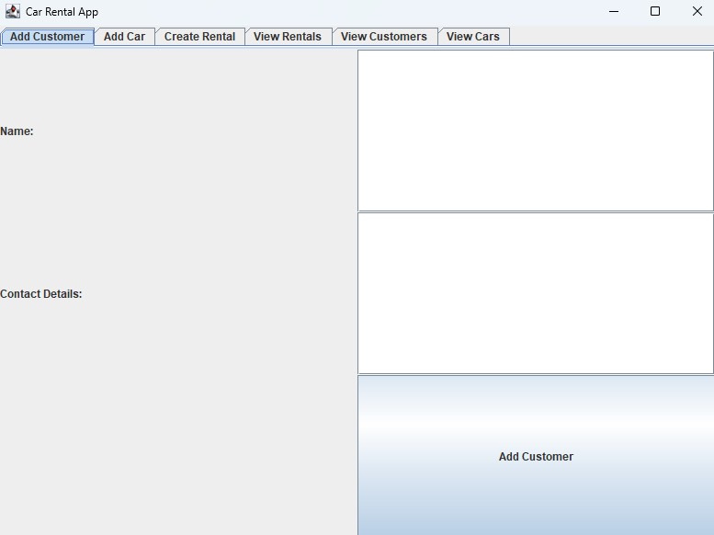
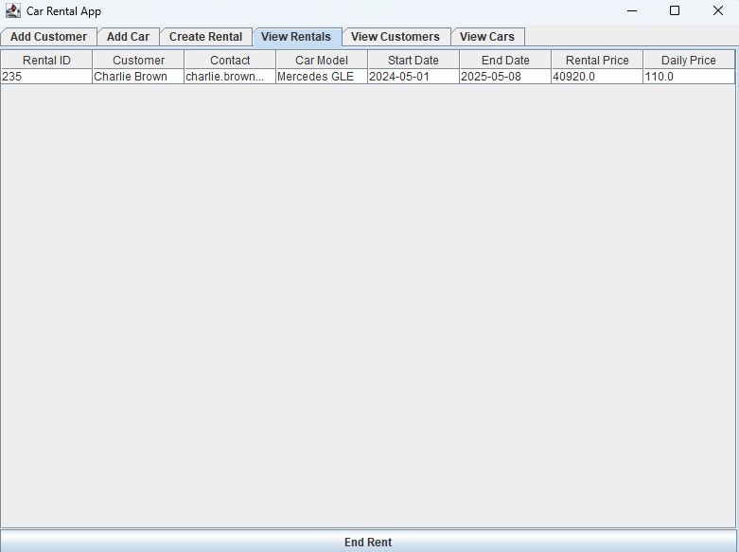
ADD &
VIEW CUSTOMERS

Slide 7
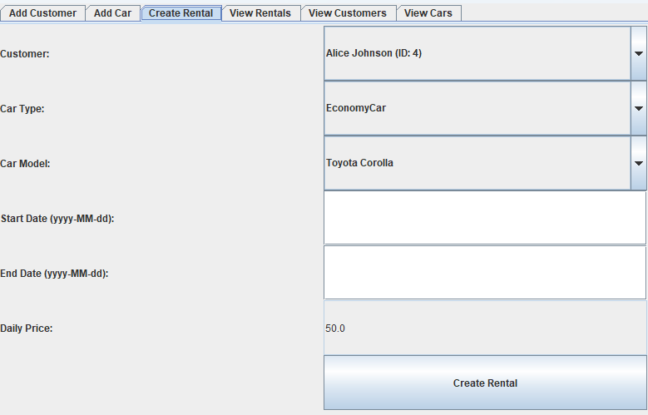
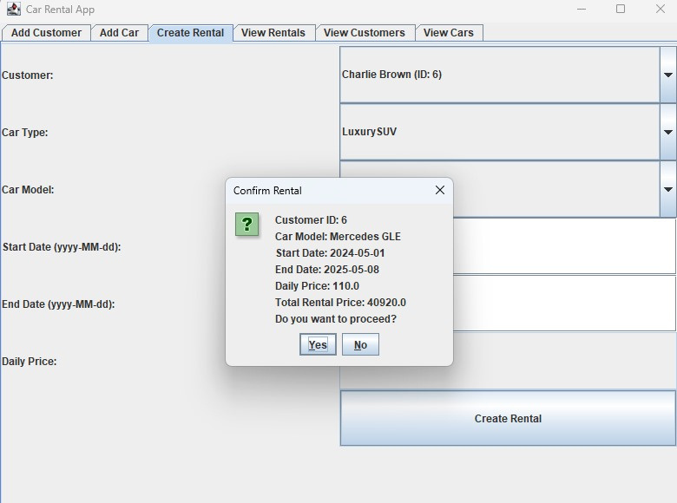
RENT A CAR

Slide 8

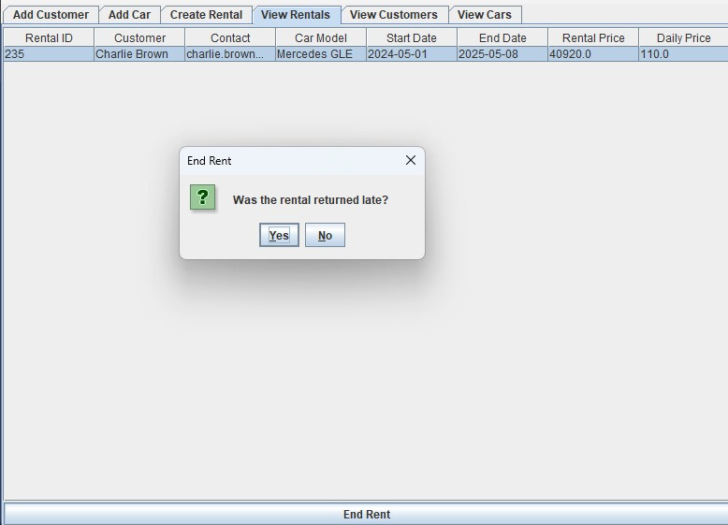
RENTALS
MANAGEMENT

Slide 9
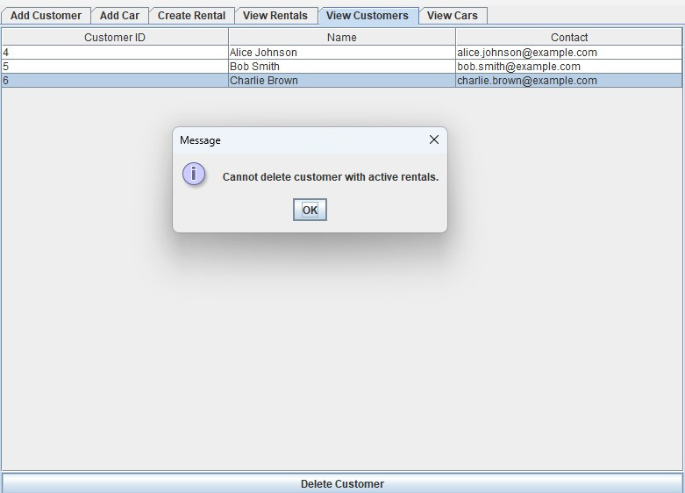
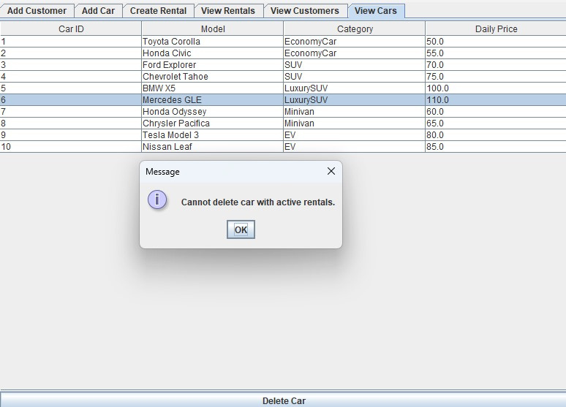
CARS &
CUSTOMERS

Slide 10
FINAL
THOUGHTS
& POSSIBLE
IMPROVEMENTS

